Slide 1

Automatic decision development 2016 - 2017

Slide 2
Four key areas for development
Development of data model
connecting new sources of customer data
Development of automated strategies
Anti-fraud, scoring, blacklists, minimum requirements
Introduction and piloting of automated strategies
Implementation of scoring checks, anti-fraud rules and other automatic customer checks, pilots
Monitoring
Development of quality monitoring systems for scoring models and auto-tests, as well as the correctness of its work

Slide 3
Four key areas for development
Development of data model
connecting new sources of customer data
Development of automated strategies
Anti-fraud, scoring, blacklists, minimum requirements
Introduction and piloting of automated strategies
Implementation of scoring checks, anti-fraud rules and other automatic customer checks, pilots
Monitoring
Development of quality monitoring systems for scoring models and auto-tests, as well as the correctness of its work

Slide 4

Main analytical tasks 2016
VN Scoring
ID Scoring + New TS Process
Calculation of profit
AF Rules VN
AF Rules ID & PH
New process PH Site
PH Scoring

Slide 5
VN Application Scoring
VN Scoring
ID Scoring + New TS Process
Calculation of profit
AF Rules VN
AF Rules ID & PH
New process PH Site
PH Scoring

Slide 6


VN Application Scoring
Problems
First trying to create scoring model
Big problems with data (excel, master file and other)
Little historical period
Non stable risk strategy in training period
Low quality of application data
Only basic application fields
Low level of understanding, how to implement model in Terrasoft
Model was developed for DSA channel
Results
We implemented this model 5.5 months
Model didn’t work properly because we have tried to use it on other channel
We couldn't change model in TS quickly
We didn't have normal point in TS for managing all our features
We understand how what we need to do

Slide 7
ID Application Scoring
Result of implementation
We spent 3 month for implementation
We realized not only scoring model it TS, but new scoring process, which gave us:
Possibility to change model and model parameters very fast
Possibility to manage all our features as Trusting Social, Scoring, BL process from one point
We created new strategy “skip pv” without verification procedure
Result of model working
We can say now that model work properly on production and quality is stable
We see that our strategies which are connected with scoring model work properly too
we have now lower BR than it could be
We reduce the costs
We increase conversation in skip pv segment
Next week we launch strategy pilot which can help us to reduce more costs and to reject more bad clients without verification
VN Scoring
ID Scoring + New TS Process
Calculation of profit
AF Rules VN
AF Rules ID & PH
New process PH Site
PH Scoring

Slide 8
ID Application Scoring
 | SCORE INTERVAL | APP | AGR | APP - > AGR | AGR EXP | BR EXP Real | BR EXP Predicted
SKIP PV | [ 0.99; 2.00) | 2039 | 1618 | 0.79 | 281 | 0.18 | 0.25
PROCEED / SKIP PV | [ 0.65; 0.99) | 5015 | 2026 | 0.40 | 320 | 0.24 | 0.32
PROCEED | [ 0.27; 0.65) | 8018 | 3009 | 0.38 | 491 | 0.27 | 0.39
PROCEED | [-0.14; 0.27) | 5626 | 1790 | 0.32 | 282 | 0.33 | 0.47
REJECT | [-2.00; -0.14) | 2695 | 0 | 0.00 | - | - | -

Slide 9

Calculation of external data profit
or Trusting Social and Iamreal, two projects - one fate
VN Scoring
ID Scoring + New TS Process
Facts:
We had two same projects
Iamreal – integration with FB for ID
Trusting social – integration with telecom operator in VN
Request cost was around 2$-3$
Integration through website
We do request firstly for all long applications and than for all accepted applications
Calculation of profit
AF Rules VN
AF Rules ID & PH
New process PH Site
PH Scoring

Slide 10

Calculation of external data profit
Results:
Both two projects give us the same quality – around GINI = 10
For better understanding is it good or bad result was created model in excel which can help us to create analysis “what if” for such projects
Calculation result:
This model give us that with average amount = 100$ and with our Bad Rate ~ 30% each GINI = 10 give us around 0.6 $ per each application with request, for situation when the decision is depends only on scoring model
We also have sales funnel, and, because of funnel, we need to compare this 0.6$ with request cost price * 5
So such external data sources is to expensive for us
We understand that we need to focus on free and very cheep data sources

Slide 11
Four key areas for development
Development of data model
connecting new sources of customer data
Development of automated strategies
Anti-fraud, scoring, blacklists, minimum requirements
Introduction and piloting of automated strategies
Implementation of scoring checks, anti-fraud rules and other automatic customer checks, pilots
Monitoring
Development of quality monitoring systems for scoring models and auto-tests, as well as the correctness of its work

Slide 12
Source of data about client
Data type | Description | VN | ID | PH | MY
Application data | Clean data from client | prod | prod | prod | prod
Iovation | Device id, device information, antifraud cheks | prod | prod | prod | prod
Facebook 1 | Autorization fact + email, name, link, photo | development (IT side) | development (IT side) | prod | development (IT side)
Facebook 2 | Friends info, additional personal info, timeline
Historical web data | Application data, Black Lists | prod (AF, BL) | prod (AF, BL) | prod (AF, BL)
Social Vector 1 | 30 universal cheks | prod | prod | prod | prod
Social Vector 2 | Additional local sites checks | development (RD side)
How client fills application | Total time, time for each page, count of correction
Historical Terrasoft Data | Data from Terrasoft about clients, defaults and other information
Geolocation | IP Geolocation , Google API, GPS coordinates
IP | Client IP | prod | prod | prod | prod
User Agent | Device type, operation system type, browser type | prod | prod | prod | prod
UTM | Marketing data | prod | prod | prod | prod
For China data sources are differ because of external factors
For new countries we are trying to realize these data sources in first time after launch
Also we are planning to create with IT minimal data kit

Slide 13
Source of data about client
Data type | Description | VN | ID | PH | MY
Application data | Clean data from client | prod | prod | prod | prod
Iovation | Device id, device information, antifraud cheks | prod | prod | prod | prod
Facebook 1 | Autorization fact + email, name, link, photo | development (IT side) | development (IT side) | prod | development (IT side)
Facebook 2 | Friends info, additional personal info, timeline
Historical web data | Application data, Black Lists | prod (AF, BL) | prod (AF, BL) | prod (AF, BL)
Social Vector 1 | 30 universal cheks | prod | prod | prod | prod
Social Vector 2 | Additional local sites checks | development (RD side)
How client fills application | Total time, time for each page, count of correction
Historical Terrasoft Data | Data from Terrasoft about clients, defaults and other information
Geolocation | IP Geolocation , Google API, GPS coordinates
IP | Client IP | prod | prod | prod | prod
User Agent | Device type, operation system type, browser type | prod | prod | prod | prod
UTM | Marketing data | prod | prod | prod | prod
2016-2017
For China data sources are differ because of external factors
For new countries we are trying to realize these data sources in first time after launch
Also we are planning to create with IT minimal data kit

Slide 14
Source of data about client
What is it? How does it work?
Data type | Description
Application data | Clean data from client
Iovation | Device id, device information, antifraud cheks
Facebook 1 | Autorization fact + email, name, link, photo
Facebook 2 | Friends info, additional personal info, timeline
Historical web data | Application data, Black Lists
Social Vector 1 | 30 universal cheks
Social Vector 2 | Additional local sites checks
How client fills application | Total time, time for each page, count of correction
Historical Terrasoft Data | Data from Terrasoft about clients, defaults and other information
Geolocation | IP Geolocation , Google API, GPS coordinates
IP | Client IP
User Agent | Device type, operation system type, browser type
UTM | Marketing data
The iovation module is installed on the site or in the app
The module collects information about the device used by the client, the device is assigned a unique identifier if it is not in the external database iovation; If the device is contained in the database, the frequency of the institution of applications from this device is analyzed.
Iovation provides device id, device information, calculated own anti-fraud rules
iovation
What and where is realized
Implemented on all prod sites VN, ID, PH, MY
implemented on dev CH
What is planned to be realized
Implement prod CH
Implement in new countries send default data to iovation
How is used
In anti-fraud rules of the form: more than one application for 21 days from one device, and with different client data for PH, VN, ID - work at the pilot stage
In the scoring card by PH
For China data sources are differ because of external factors
For new countries we are trying to realize these data sources in first time after launch
Also we are planning to create with IT minimal data kit
How is planned to be used
In anti-fraud inspections and in scoring models of all countries

Slide 15
Source of data about client
How does it work?
Data type | Description
Application data | Clean data from client
Iovation | Device id, device information, antifraud cheks
Facebook 1 | Autorization fact + email, name, link, photo
Facebook 2 | Friends info, additional personal info, timeline
Historical web data | Application data, Black Lists
Social Vector 1 | 30 universal cheks
Social Vector 2 | Additional local sites checks
How client fills application | Total time, time for each page, count of correction
Historical Terrasoft Data | Data from Terrasoft about clients, defaults and other information
Geolocation | IP Geolocation , Google API, GPS coordinates
IP | Client IP
User Agent | Device type, operation system type, browser type
UTM | Marketing data
Receive data:
Email
Name
Page link
Gender
Facebook_id
Facebook
What and where is realized
Implemented on all prod sites PH
In the process of implementation on MY, ID, VN
What is planned to be realized
To expand the volume of FB data
How is used
Accumulation of statistics
How is planned to be used
In anti-fraud inspections and in scoring models of all countries
mandatory authorization via FB on one of the sites
collection
For China data sources are differ because of external factors
For new countries we are trying to realize these data sources in first time after launch
Also we are planning to create with IT minimal data kit

Slide 16
Source of data about client
How does it work?
Data type | Description
Application data | Clean data from client
Iovation | Device id, device information, antifraud cheks
Facebook 1 | Autorization fact + email, name, link, photo
Facebook 2 | Friends info, additional personal info, timeline
Historical web data | Application data, Black Lists
Social Vector 1 | 30 universal cheks
Social Vector 2 | Additional local sites checks
How client fills application | Total time, time for each page, count of correction
Historical Terrasoft Data | Data from Terrasoft about clients, defaults and other information
Geolocation | IP Geolocation , Google API, GPS coordinates
IP | Client IP
User Agent | Device type, operation system type, browser type
UTM | Marketing data
Historical data
The information available on the site is used to find applications in the past that are associated with the application being processed by one of the parameters
What and where is realized
implemented in the form of AF rules iovation on prod sites PH, ID, VN
What is planned to be realized
New types of anti-fraud rules and other rules related to social ties
How is planned to be used
As scoring variables
For rejection rules
For China data sources are differ because of external factors
For new countries we are trying to realize these data sources in first time after launch
Also we are planning to create with IT minimal data kit

Slide 17
Source of data about client
Data type | Description
Application data | Clean data from client
Iovation | Device id, device information, antifraud cheks
Facebook 1 | Autorization fact + email, name, link, photo
Facebook 2 | Friends info, additional personal info, timeline
Historical web data | Application data, Black Lists
Social Vector 1 | 30 universal cheks
Social Vector 2 | Additional local sites checks
How client fills application | Total time, time for each page, count of correction
Historical Terrasoft Data | Data from Terrasoft about clients, defaults and other information
Geolocation | IP Geolocation , Google API, GPS coordinates
IP | Client IP
User Agent | Device type, operation system type, browser type
UTM | Marketing data
Social Vector
How does it work?
get information on the list
What and where is realized
Implemented on all prod sites PH
In the process of implementation on MY, ID, VN
What is planned to be realized
To expand the volume of FB data
How is used
Accumulation of statistics
How is planned to be used
For China data sources are differ because of external factors
For new countries we are trying to realize these data sources in first time after launch
Also we are planning to create with IT minimal data kit
In anti-fraud inspections and in scoring models of all countries
mandatory authorization via FB on one of the sites
collection

Slide 18
Source of data about client
Data type | Description
Application data | Clean data from client
Iovation | Device id, device information, antifraud cheks
Facebook 1 | Autorization fact + email, name, link, photo
Facebook 2 | Friends info, additional personal info, timeline
Historical web data | Application data, Black Lists
Social Vector 1 | 30 universal cheks
Social Vector 2 | Additional local sites checks
How client fills application | Total time, time for each page, count of correction
Historical Terrasoft Data | Data from Terrasoft about clients, defaults and other information
Geolocation | IP Geolocation , Google API, GPS coordinates
IP | Client IP
User Agent | Device type, operation system type, browser type
UTM | Marketing data
How does it work?
Information about the marketing source
What and where is realized
UTM
Implemented on all prod sites PH, MY, ID, VN
What is planned to be realized
Together with the marketing department to fix the rules for filling UTM tags
to collect detailed information about the launched companies
How is planned to be used
As scoring variables
Analyze the quality of marketing segments by recurrence / default
For China data sources are differ because of external factors
For new countries we are trying to realize these data sources in first time after launch
Also we are planning to create with IT minimal data kit

Slide 19
Source of data about client
How client fills application
Data type | Description
Application data | Clean data from client
Iovation | Device id, device information, antifraud cheks
Facebook 1 | Autorization fact + email, name, link, photo
Facebook 2 | Friends info, additional personal info, timeline
Historical web data | Application data, Black Lists
Social Vector 1 | 30 universal cheks
Social Vector 2 | Additional local sites checks
How client fills application | Total time, time for each page, count of correction
Historical Terrasoft Data | Data from Terrasoft about clients, defaults and other information
Geolocation | IP Geolocation , Google API, GPS coordinates
IP | Client IP
User Agent | Device type, operation system type, browser type
UTM | Marketing data
Parameterize the features of filling the application by the client
Time to fill each field
Number of fixes for each field
Time between fields filling
Other features
Use in scoring models and anti-fraud rules
New data source
Historical Terrasoft Data
Integrate the site with Terrasof in terms of receiving additional data on the client
Receive data about delays of this client
receive data about delays of related persons
Use in scoring models, anti-fraud rules and behavioral scoring
Geolocation
Integrate with Google service to retrieve geolocation data using Google API Geolocation
Use in anti-fraud rules
For China data sources are differ because of external factors
For new countries we are trying to realize these data sources in first time after launch
Also we are planning to create with IT minimal data kit

Slide 20
Source of data about client
Data type | Description | VN | ID | PH | MY
Application data | Clean data from client | prod | prod | prod | prod
Iovation | Device id, device information, antifraud cheks | prod | prod | prod | prod
Facebook 1 | Autorization fact + email, name, link, photo | development (IT side) | development (IT side) | prod | development (IT side)
Facebook 2 | Friends info, additional personal info, timeline
Historical web data | Application data, Black Lists | prod (AF, BL) | prod (AF, BL) | prod (AF, BL)
Social Vector 1 | 30 universal cheks | prod | prod | prod | prod
Social Vector 2 | Additional local sites checks | development (RD side)
How client fills application | Total time, time for each page, count of correction
Historical Terrasoft Data | Data from Terrasoft about clients, defaults and other information
Geolocation | IP Geolocation , Google API, GPS coordinates
IP | Client IP | prod | prod | prod | prod
User Agent | Device type, operation system type, browser type | prod | prod | prod | prod
UTM | Marketing data | prod | prod | prod | prod
2016-2017
For China data sources are differ because of external factors
For new countries we are trying to realize these data sources in first time after launch
Also we are planning to create with IT minimal data kit

Slide 21
Four key areas for development
Development of data model
connecting new sources of customer data
Development of automated strategies
Anti-fraud, scoring, blacklists, minimum requirements
Introduction and piloting of automated strategies
Implementation of scoring checks, anti-fraud rules and other automatic customer checks, pilots
Monitoring
Development of quality monitoring systems for scoring models and auto-tests, as well as the correctness of its work

Slide 22
New Anti-Fraud rules for VN
Have been realized
VN Scoring
Rule Type: applications for which we find applications for last 2 weeks with same field: | Bad rate if AFrule = 0 | Bad rate if AFrule = 1 | Hit Rate
iovation_device_alias | 0.22 | 0.33 | 9.8%
IP | 0.23 | 0.31 | 7.1%
IP without last block | 0.21 | 0.26 | 47.9%
mobile_phone | 0.23 | 0.26 | 7.8%
document_number | 0.23 | 0.26 | 8.5%
ID Scoring + New TS Process
Calculation of profit
AF Rules VN
AF Rules ID & PH
In plan
Rule Type: applications for wich we find applications with same device id for two last 2 weeks but with differ field: | Bad rate if AFrule = 0 | Bad rate if AFrule = 1 | Hit Rate | Information value
date_of_birth | 0.22 | 0.50 | 3.7% | 0.07
document_number | 0.23 | 0.47 | 3.6% | 0.05
mobile_phone | 0.23 | 0.44 | 4.2% | 0.05
company_phone | 0.22 | 0.41 | 6.5% | 0.05
guarantor_phone | 0.22 | 0.39 | 7.1% | 0.05
IP without last block | 0.23 | 0.36 | 5.5% | 0.03
email | 0.23 | 0.33 | 2.4% | 0.01
New process PH Site
PH Scoring

Slide 23
New Anti-Fraud rules for PH and ID
Have been realized
VN Scoring
Rule Type: applications for wich we find applications with same device id for two last 3 weeks but with differ field: | Timelag | Bad rate if AFrule = 0 | Bad rate if AFrule = 1 | Hit Rate
date_of_birth | 21 | 0.36 | 0.46 | 4.1%
mobile_phone | 21 | 0.36 | 0.49 | 4.2%
company_phone | 21 | 0.36 | 0.49 | 5.5%
guarantor_phone | 21 | 0.36 | 0.48 | 5.5%
account_number | 21 | 0.36 | 0.50 | 4.3%
email | 21 | 0.36 | 0.45 | 4.3%
document_number | 21 | 0.36 | 0.46 | 4.9%
IP4 | 21 | 0.36 | 0.44 | 3.8%
IP3 | 21 | 0.36 | 0.49 | 3.2%
IP2 | 21 | 0.36 | 0.47 | 1.2%
ID Scoring + New TS Process
Calculation of profit
AF Rules VN
AF Rules ID & PH
New process PH Site
PH Scoring

Slide 24
New Anti-Fraud rules for PH and ID
In plan
Rule Type: applications for wich we find applications for last 3 weeks with same field: | Bad rate if AFrule = 0 | Bad rate if AFrule = 1 | Hit Rate
mobile_phone | 0.38 | 0.46 | 0.14
email | 0.38 | 0.44 | 0.13
guarantor_phone | 0.38 | 0.49 | 0.09
document_number | 0.38 | 0.47 | 0.10
account_number | 0.38 | 0.47 | 0.12
ip | 0.37 | 0.42 | 0.34
full_name | 0.38 | 0.49 | 0.10
company_phone | 0.38 | 0.42 | 0.18
living_home_phone | 0.38 | 0.44 | 0.13
company_name | 0.37 | 0.43 | 0.34
iovation_device_alias | 0.39 | 0.44 | 0.03

Slide 25
PH Scoring
Get Iovation data process
Get FB data process
External data receiving
VN Scoring
ID Scoring + New TS Process
Iovation AF Rules
input: iovation device alias, application data
output: vector
Iovation BL Rules
input: iovation device alias, BL
output: vector
AF Rules
input: iovation device alias + application data
output: vector
Calculation of extra variables
Calculation of profit
+ output Black List
AF Rules VN
IAF Strategy (SQL Proc)
input: IAFRules + BLRules
Output IAFStrategyResult (0,1)
AF Strategy (SQL Proc)
Planned to realize
input: AFRules
output AFStrategyResult (0,1)
Scoring (SQL Proc)
input: AFRules + Application Data + UserAgent + iovation data + UTM + Facebook data + SocVectorData
output ASStrategyResult(0,1,2)
AF Rules ID & PH
Strategy calculation
New process PH Site
PH Scoring
Final Strategy
input: IAFStrategyResult
ASStrategyResult
output: Strategy (0,1,2)
Calculation of final strategy
Send to TS

Slide 26
PH Scoring
VN Scoring
Result of implementation
We spent 2-3 week for implementation
We realized not only scoring model on WEB, but new scoring process, which gave us:
Possibility to change model and model parameters very fast
Possibility to manage all our features as from one point
Result of modeling
We can say that model work properly on production and quality is stable
We can get such results:
Reduce Bad Rate by 10% (43 -> 33)
Reduce by 40% our vinificators' load
Save AR on current level
ID Scoring + New TS Process
Calculation of profit
AF Rules VN
AF Rules ID & PH
New process PH Site
PH Scoring

Slide 27
PH Scoring
Period 2016w35 - 2016w50
score interval |  | count apps | count agreement | conversion
[ min | max ]
0.00 | 0.30 | 8522 | 1523 | 18%
0.30 | 0.35 | 8522 | 1595 | 19%
0.35 | 0.40 | 8523 | 1336 | 16%
0.4 | 0.46 | 8522 | 1345 | 16%
0.46 | 1.00 | 8523 | 1292 | 15%
Period 2016w35 - 2016w50
score interval |  | count of agrements | % of agreements | count of defaults | BR | New strategy
[ min | max ]
0.00 | 0.30 | 213 | 0.19 | 50 | 23% | low level of defaults, can be without "pv verification" which can increase the conversion twice
0.31 | 0.35 | 210 | 0.19 | 77 | 37% | clients for normal procced strategy
0.35 | 0.40 | 238 | 0.22 | 100 | 42%
0.41 | 0.46 | 188 | 0.17 | 95 | 51%
0.46 | 1.00 | 251 | 0.23 | 159 | 63% | very high level of defaults, should be rejected

Slide 28
Four key areas for development
Development of data model
connecting new sources of customer data
Development of automated strategies
Anti-fraud, scoring, blacklists, minimum requirements
Introduction and piloting of automated strategies
Implementation of scoring checks, anti-fraud rules and other automatic customer checks, pilots
Monitoring
Development of quality monitoring systems for scoring models and auto-tests, as well as the correctness of its work

Slide 29
Analytical module
WEB Analytical Module
TS Analytical Module
APP
WEB
Internal data
External data
Additional data calculation
Deduplication
Anti Fraud rules Stop Factors
Minimal Requirements
Deduplication
Black Lists Rules
TS Application Scoring model
Anti Fraud expert rules, Black lists
Stop Factors,
Minimal Requirements
WEB Decision rules
TS Application Scoring Model
Final Decision
Final Decision
TS

Slide 30
Analytical module ID
WEB Analytical Module
TS Analytical Module
APP
WEB
Internal data
External data
Additional data calculation
Deduplication
Anti Fraud rules Stop Factors
Minimal Requirements
Deduplication
Black Lists Rules
TS Application Scoring model
Anti Fraud expert rules, Black lists
Stop Factors,
Minimal Requirements
WEB Decision rules
TS Application Scoring Model
Final Decision
Final Decision
TS

Slide 31
Analytical module PH
WEB Analytical Module
TS Analytical Module
APP
WEB
Internal data
External data
Additional data calculation
Deduplication
Anti Fraud rules Stop Factors
Minimal Requirements
Deduplication
Black Lists Rules
TS Application Scoring model
Anti Fraud expert rules, Black lists
Stop Factors,
Minimal Requirements
Final Decision
WEB Decision rules
TS

Slide 32
Four key areas for development
Development of data model
connecting new sources of customer data
Development of automated strategies
Anti-fraud, scoring, blacklists, minimum requirements
Introduction and piloting of automated strategies
Implementation of scoring checks, anti-fraud rules and other automatic customer checks, pilots
Monitoring
Development of quality monitoring systems for scoring models and auto-tests, as well as the correctness of its work

Slide 33
Conclusions
Aims:
We do not want just to implement some analytics, we want to create analytical system for each country
which is consist from simple independent blocks with different functions
which can give us possibilities do any changes as fast as possible
with all free and cheep data sources, which we find
We want to do the same system for CH, MY and for new countries
Next year we also want to focus on repeat sales to create the same process for them
And we are planning to create good monitoring system for it

Slide 34

Conclusions
Aims:
We do not want just to implement some analytics, we want to create analytical system for each country
which is consist from simple independent blocks with different functions
which can give us possibilities do any changes as fast as possible
with all free and cheep data sources, which we find
We want to do the same system for CH, MY and for new countries
Next year we also want to focus on repeat sales to create the same process for them
And we are planning to create good monitoring system for it

Slide 35
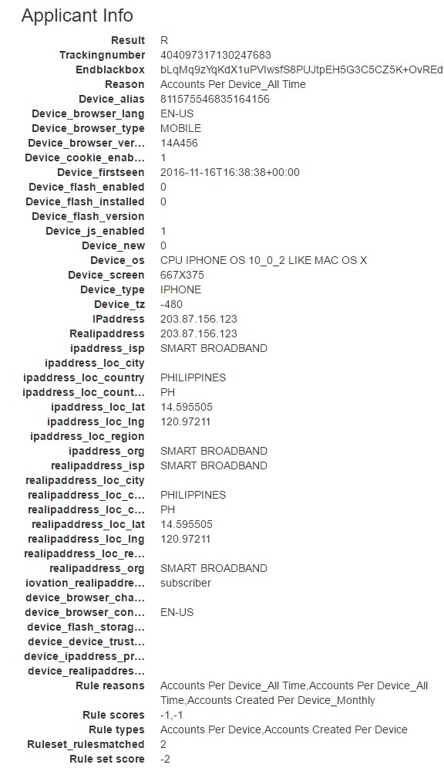
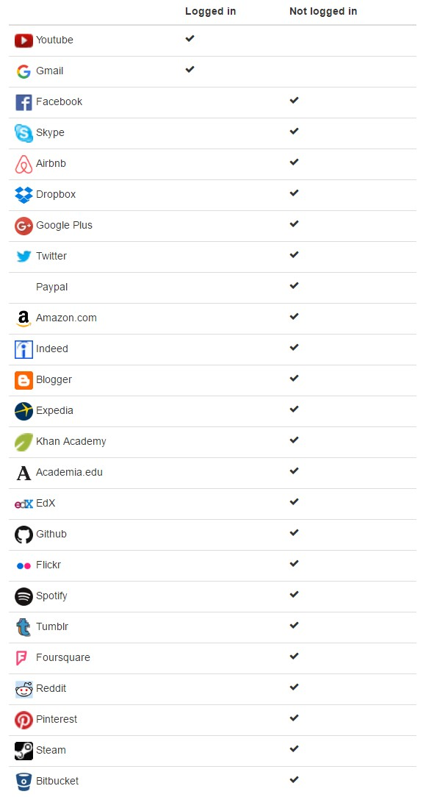
Source of data about client. Annex

